Slide 1
Model Selection, Regularization
Machine Learning 10-601B
Seyoung Kim
Many of these slides are derived from Ziv-Bar Joseph. Thanks!

Slide 2

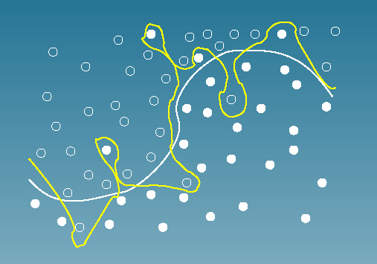
The battle against overfitting

Slide 3
Model Selection
Suppose we are trying select among several different models for a learning problem.
Examples:
1. polynomial regression
Model selection: we wish to automatically and objectively decide if k should be, say, 0, 1, . . . , or 10.
2. Principal component analysis
The number of principal components to use for dimensionality reduction
3. Mixture models and hidden Markov model,
Model selection: we want to decide the number of hidden states
The Problem:
Given model family , find s.t.

Slide 4
1. Cross Validation
We are given training data D and test data D_{test}, and we would like to fit this data with a model p_{i}(x;q) from the family F (e.g, an linear regression), which is indexed by i and parameterized by q.
K-fold cross-validation (CV)
Set aside a*N samples of D. This is known as the held-out data and will be used to evaluate different models indexed by i.
For each candidate model i, fit the optimal hypothesis p_{i}(x;q*) to the remaining (1−a)N samples in D (i.e., hold i fixed and find the best q).
Evaluate each model p_{i}(x|q*) on the held-out data using some pre-specified risk function.
Repeat the above K times, choosing a different held-out data set each time, and the scores are averaged for each model p_{i}(.) over all held-out data set. This gives an estimate of the risk curve of models for different i.
For the model with the lowest risk, say p_{i}*(.), we use all of D to find the parameter values for p_{i}*(x;q*).

Slide 5
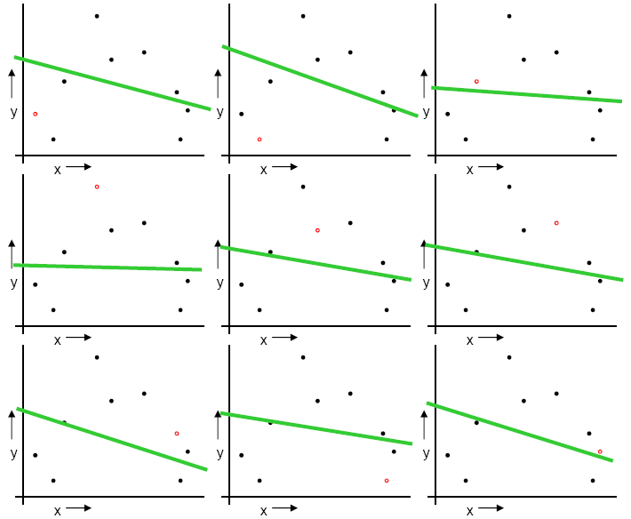
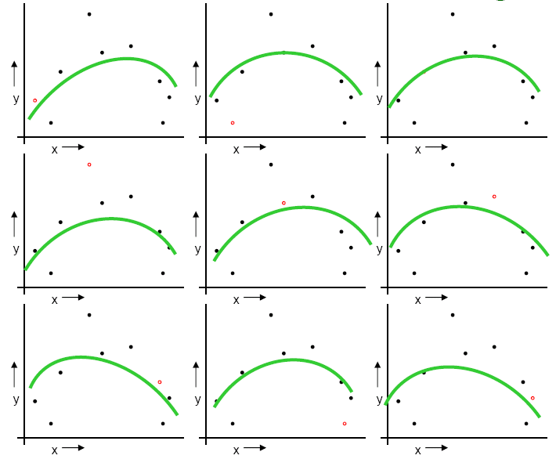
Example:
When α=1/N, the algorithm is known as Leave-One-Out-Cross-Validation (LOOCV)
MSELOOCV(M₁)=2.12
MSELOOCV(M₂)=0.962

Slide 6
Practical issues for CV
How to decide the values for K and α
Commonly used K = 10 and α = 0.1.
when data sets are small relative to the number of models that are being evaluated, we need to decrease α and increase K
K needs to be large for the variance to be small enough, but this makes it time-consuming.
One important point is that the test data D_{test} is never used in CV, because doing so would result in overly (indeed dishonest) optimistic accuracy rates during the testing phase.

Slide 7
2. Feature Selection
Imagine that you have a supervised learning problem where the number of features d is very large (perhaps d >>#samples), but you suspect that there is only a small number of features that are "relevant" to the learning task.
This scenario is likely to lead to high generalization error – the learned model will potentially overfit unless the training set is fairly large.
So let’s get rid of useless parameters!
Notes:
One special and important case of model selection is called feature selection.

Slide 8
How to score features
How do you know which features can be pruned?
Given labeled data, we can compute some simple score S(i) that measures how informative each feature x_{i} is about the class labels y.
Ranking criteria:
Mutual Information: score each feature by its mutual information with respect to the class labels
We need estimate the relevant p()'s from data, e.g., using MLE

Slide 9
Feature selection schemes
Given n features, there are 2^{n} possible feature subsets
Thus feature selection can be posed as a model selection problem over 2^{n} possible models.
For large values of n, it's usually too expensive to explicitly enumerate over and compare all 2^{n} models. Some heuristic search procedure is used to find a good feature subset.
Two general approaches:
Filter: i.e., direct feature ranking, but taking no consideration of the subsequent learning algorithm
add (from empty set) or remove (from the full set) features one by one based on model scoring scheme S(i)
E.g., forward selection for linear regression
Cheap, but is subject to local optimality and may be unrobust under different classifiers
Wrapper: determine the (inclusion or removal of) features based on performance under the learning algorithms to be used. (See next slide)
Performs a greedy search over subsets of features
After each inclusion/removal, the learning algorithm should learn the optimal parameters
E.g., forward (backward) selection for linear regression

Slide 10
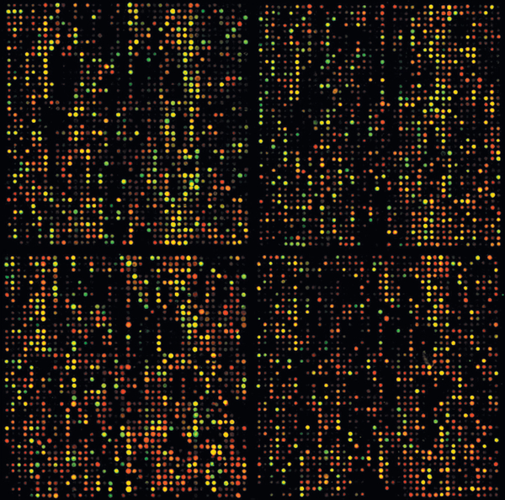
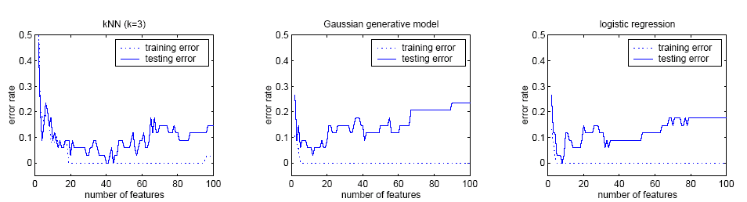
Case study [Xing et al, 2001]
The case:
7130 genes from a microarray dataset
72 samples
47 type I Leukemias (called ALL)
and 25 type II Leukemias (called AML)
Three classifier:
kNN
Gaussian classifier
Logistic regression

Slide 11
3. Information criterion
Suppose we are trying select among several different models for a learning problem.
The Problem:
Given model family , find s.t.
We can design J that not only reflect the predictive loss, but also the amount of information M_{k} can hold

Slide 12
Model Selection via Information Criteria
Let f(x) denote the truth, the underlying distribution of the data
Let g(x,θ) denote the model family we are evaluating
f(x) does not necessarily reside in the model family
θ_{ML}(y) denote the MLE of model parameter from data y
Among early attempts to move beyond Fisher's Maliximum Likelihood framework, Akaike proposed the following information criterion:
which is, of course, intractable (because f(x) is unknown)

Slide 13
AIC
AIC (An information criterion, not Akaike information criterion)
where k is the number of parameters in the model

Slide 14
4. Regularization
Maximum-likelihood estimates are not always the best
Alternative: we "regularize" the likelihood objective (also known as penalized likelihood, shrinkage, smoothing, etc.), by adding to it a penalty term:
where ||θ|| might be the L1 or L2 norm.
The choice of norm has an effect
using the L2 norm pulls directly towards the origin,
while using the L1 norm pulls towards the coordinate axes, i.e it tries to set some of the coordinates to 0.
This second approach can be useful in a feature-selection setting.

Slide 15
Recall Bayesian and Frequentist
Frequentist interpretation of probability
Probabilities are objective properties of the real world, and refer to limiting relative frequencies (e.g., number of times I have observed heads). Hence one cannot write P(Katrina could have been prevented|D), since the event will never repeat.
Parameters of models are fixed, unknown constants. Hence one cannot write P(θ|D) since θ does not have a probability distribution. Instead one can only write P(D|θ).
One computes point estimates of parameters using various estimators, θ*= f(D), which are designed to have various desirable qualities when averaged over future data D (assumed to be drawn from the “true” distribution).
Bayesian interpretation of probability
Probability describes degrees of belief, not limiting frequencies.
Parameters of models are random variables, so one can compute P(θ|D) or P(f(θ)|D) for some function f.
One estimates parameters by computing P(θ|D) using Bayes rule:

Slide 16
Review: Bayesian interpretation of regularization
Regularized Linear Regression
Recall that using squared error as the cost function results in the least squared error estimate
And assume iid data and Gaussian noise, LSE estimate is equivalent to MLE of β
Now assume that vector β follows a normal prior with 0-mean and a diagonal covariance matrix
What is the posterior distribution of β?

Slide 17
Review: Bayesian interpretation of regularization, con'd
The posterior distribution of β
This leads to a now objective
This is L₂ regularized linear regression! --- a MAP estimation of β
How to choose λ.
cross-validation!
Does not perform a model selection directly

Slide 18
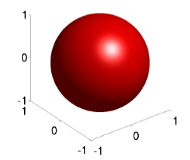
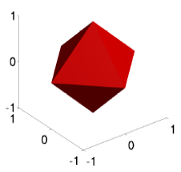
Regularized Regression
Recall linear regression:
Regularized LR:
L2-regularized LR:
where
L1-regularized LR:
where
Performs a model selection directly

Slide 19
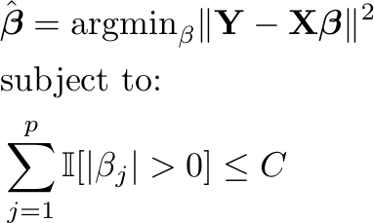
Sparsity
Consider least squares linear regression problem:
Sparsity “means” most of the beta’s are zero.
But this is not convex!!! Many local optima, computationally intractable.
x₁
β₁
x₂
β₂
β₃
x₃
y
…
β_{n-1}
x_{n-1}
β_{n}
x_{n}
Notes:
Consider the least squares problem.
Ideally, we would like to achieve sparsity by simply restricting the number of of regression coefficients that are nonzero.
However, there is a problem. This sparsity constraint is non-convex, meaning optimization is computationally difficult. There are many local optima, and it is likely that optimizing the objective will get stuck in one of them.
Thus we will never get to the global optimum and have to resort to heuristics to avoid local optima. Furthermore the constraint is not-smooth amking optimization more difficult.
Laplace Max-margin Markov Networks
19

Slide 20
Sparsity
Consider least squares linear regression problem:
Sparsity “means” most of the beta’s are zero.
But this is not convex!!! Many local optima, computationally intractable.
x₁
β₁
x₂
β₃
x₃
y
…
x_{n-1}
β_{n}
x_{n}
Notes:
Consider the least squares problem.
Ideally, we would like to achieve sparsity by simply restricting the number of of regression coefficients that are nonzero.
However, there is a problem. This sparsity constraint is non-convex, meaning optimization is computationally difficult. There are many local optima, and it is likely that optimizing the objective will get stuck in one of them.
Thus we will never get to the global optimum and have to resort to heuristics to avoid local optima. Furthermore the constraint is not-smooth amking optimization more difficult.
Laplace Max-margin Markov Networks
20

Slide 21
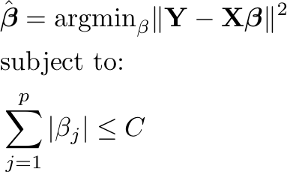
L1 Regularization (LASSO) (Tibshirani, 1996)
A convex relaxation.
Still enforces sparsity!
Constrained Form
Lagrangian Form
Notes:
L1 regularized regression (commonly known as the LASSO) is a convex relaxation. Instead of limiting the number of nonzero coefficients, we constrain the absolute values of coefficients.
Although this penalty introduces some bias (it still shrinks relevant coefficients as well as irrelevant ones), it is effective at enforcing sparsity.
Consider the example of the diagram that shows the level sets of an objective function and the feasible set imposed by the L1-penalty. Intuitively, the objective function will be minimized at a corner of the feasible set, resulting in a sparse solution.
Since the problem is convex, an exact solution can be achieved.
Laplace Max-margin Markov Networks
21

Slide 22
Ridge Regression
Trait
Genotype
Association Strength
2.1
=
x
T G A A C C A T G A A G T A
Many non-zero input features (genotypes):
Which genotypes are truly significant?

Slide 23
Lasso Achieve Sparsity and Reduce False Positives
Trait
Genotype
Association Strength
2.1
=
x
T G A A C C A T G A A G T A
Lasso (l1 penalty) results in sparse solutions – vector with more zero coordinates
Good for high-dimensional problems – don’t have to store or even “measure” all coordinates!

Slide 24
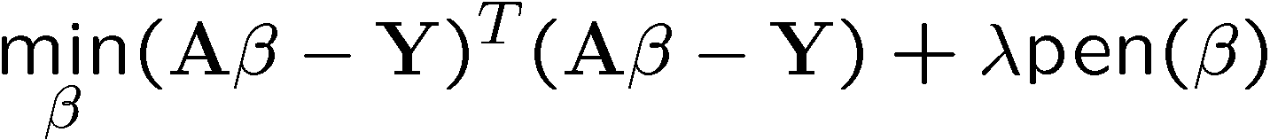
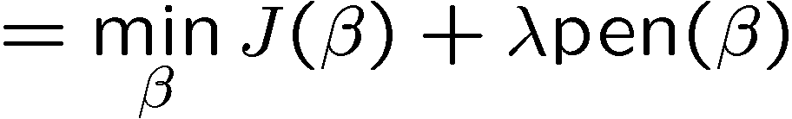
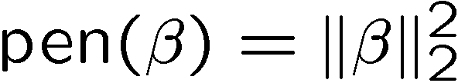

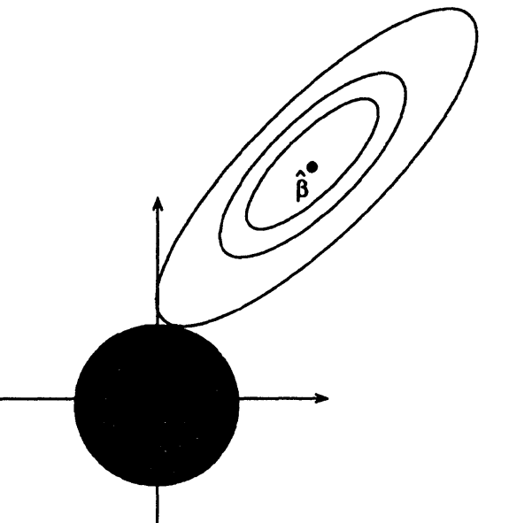
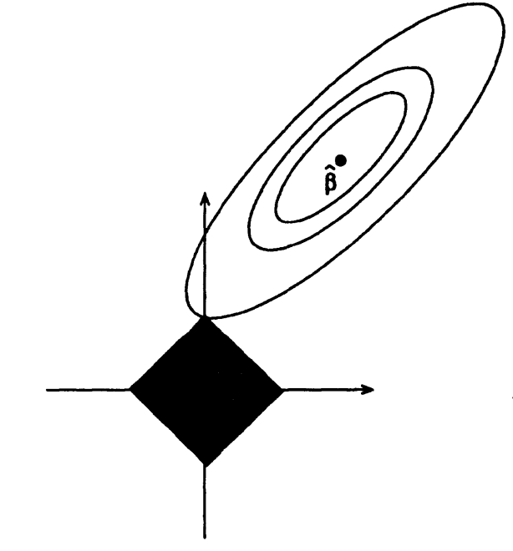
Regularized Linear Regression
Ridge Regression vs Lasso
X
X
Ridge Regression: Lasso:
HOT!
βs with constant J(β)
(level sets of J(β))
βs with
constant
l2 norm
β2
βs with
constant
l1 norm
β1

Slide 25

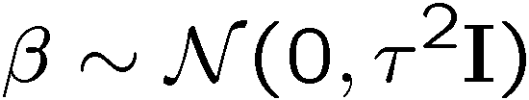
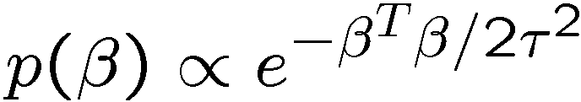
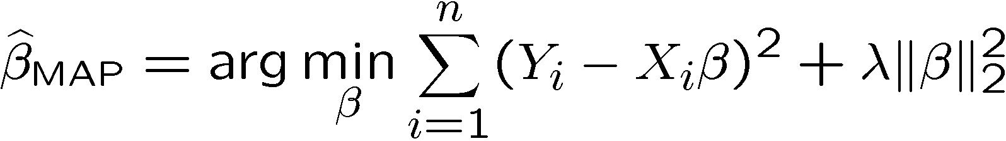
Regularized Least Squares and MAP
log likelihood
log prior
I) Gaussian Prior
0
Ridge Regression
Closed form: HW
Prior belief that β is Gaussian with zero-mean biases solution to “small” β

Slide 26
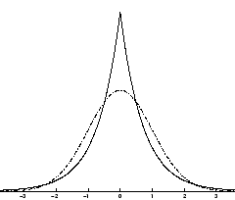
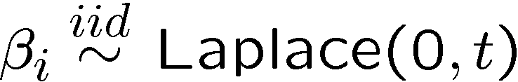
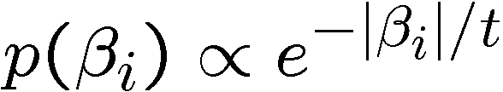
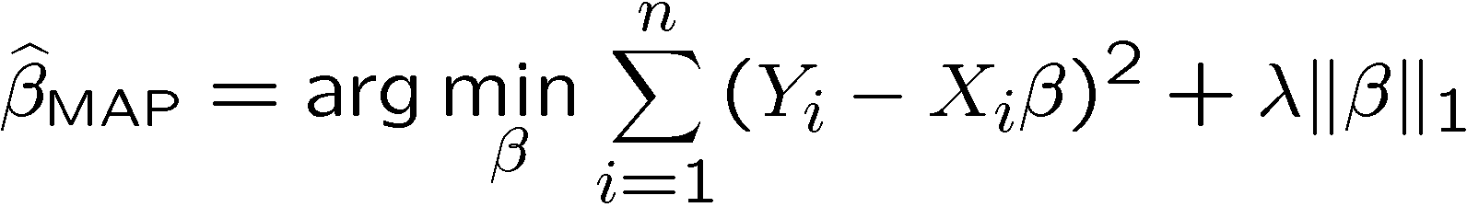

Regularized Least Squares and MAP
log likelihood
log prior
II) Laplace Prior
Lasso
Closed form: HW
Prior belief that β is Laplace with zero-mean biases solution to “small” β

Slide 27
5. Bayesian Model Averaging
Recall the Bayesian Theory: (e.g., for data D and model M)
Consider Δ quantity of interest like some future observation, utility of a course of action etc. This is the average of the posterior distributions under each model.
We want to weight each distribution by the posterior model probability.
The posterior is the likelihood times the prior, up to a constant

Slide 28
5. Bayesian Model Averaging cont’d
Assume that P(M_{i}) is uniform and notice that P(D) is constant, then, we just need to find the following:
After a few steps of approximations and calculations (you will see this in advanced ML class in later semesters), you will get this:
where k_{i} is the number of parameters, and N is the number of data points in D.
This is the Bayesian information criterion (BIC).

Slide 29
Real-world Application: Gene Regulatory Networks
High throughput ChIP-seq data tells us where regulatory proteins called TFs bind. However, most bindings are not functional.

Slide 30
Learn Bayesian Network from Data
Expression
Data
Target Genes
Downstream
Genes
TFs
For target genes, we use prior information to select TF regulators from subset of TFs
Notes:
It is noting that a TF’s target can be another TF which is what we have on the left here.

Slide 31
Each gene is modeled with Linear Regression
Pa(Y_{j})
Pa(Y_{j})
Y_{j}
Notes:
It is noting that a TF’s target can be another TF which is what we have on the left here.

Slide 32
Use L₁-Regularization for Feature Selection
Pa(Y_{j})
Pa(Y_{j})
Y_{j}
Notes:
It is noting that a TF’s target can be another TF which is what we have on the left here.

Slide 33
Summary
The battle against overfitting:
Cross validation
Feature selection
Regularization
Bayesian Model Averaging
Real world application: estimating gene regulatory networks.

